Slide 1
StyleGAN encoder for image-to-image translation
Vision and Perception
project
September, 2021 (Amila Sikalo - 1938032) & (Olga Sorokoletova - 1937430)

Slide 2
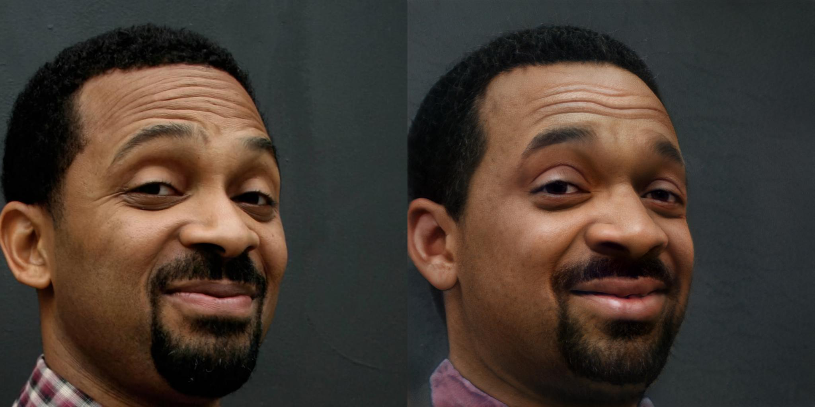
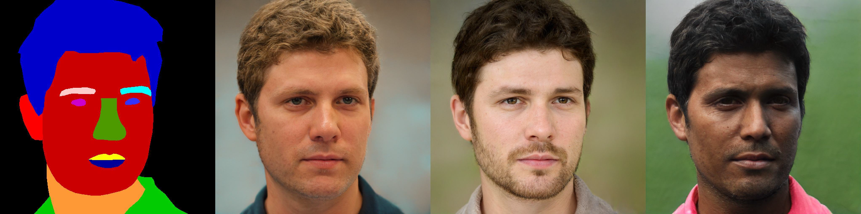
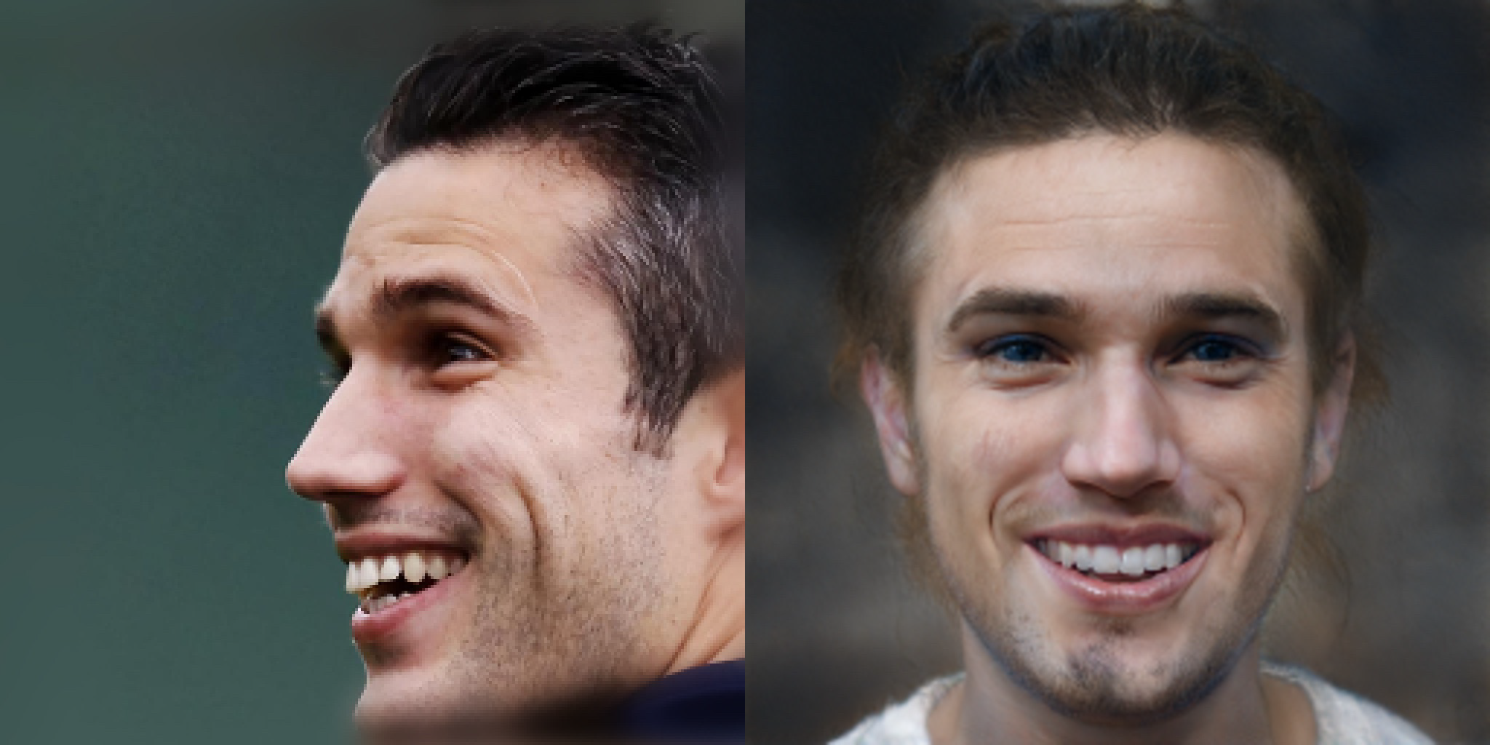
Project Goal and Overview
Given: Variety of image-to-image translation tasks
Goal: Generic framework - pixel2style2pixel (pSp)
Novelty: ENCODER that directly generates style vectors in 𝒲⁺
New methodology for utilizing pre-trained StyleGAN generator.
StyleGAN encoder for image-to-image translation
Notes:
Let’s start from the general idea of the paper which was to create a general framework suitable for solving variety of image-to-image translation tasks, such as inversion, face frontalization, conditional image synthesis and many others. Because, there are already existing methods for handling each of these tasks separately, they were introduced in the more recent papers and show high performance, but the uniqueness of proposed framework is that it can be applied to any of the aforementioned tasks and doesn’t depend on the input domain. The framework is called pixel2style2pixel and from the functional point of view it consists of a specific encoder that is able to directly generate style vectors in the extended latent space and methodology to combine it with a pre-trained StyleGAN generator.

Slide 3
Advantages over previous algorithms
No additional optimization over latent space;
Domain-independent;
Supports multi-modal synthesis;
Support for tasks without p2p correspondence;
No adversary required.
StyleGAN encoder for image-to-image translation
Notes:
Method has several advantages over previous algorithms. One of them is that no additional optimization in the latent space is required, which is a very desirable property, because optimization over latent space is usually a time-consuming operation. Then, as already said, psp is domain-independent and therefore allows handling of the tasks which a priori require the presence of several domains and also support multi-modal synthesis and solving of the tasks without p2p correspondence. The next point is that since the generator is taken from the Style GAN as pre-trained, discriminator is not used and therefore training is going on in the simplified form without all of the challenges related to adversary.

Slide 4
StyleGAN
STYLE-based generator architecture (operates globally instead of locally);
State-of-the-art visual quality on the high resolution images;
Disentangled LATENT SPACE 𝒲.
01
𝒲
Meaningful manipulations can be performed
“Invert first, edit later” approach
512-dimensional vector w
02
𝒲⁺
More accurate reconstruction
Per-image optimization
18 different 512-dimensional vectors w
03
Encoder
Accelerates optimization process
Infer an approximate vector
Additional optimization is required
Trade-off: FAST vs ACCURATE inversion (?)
StyleGAN encoder for image-to-image translation
Notes:
Coming to the architecture, one of the 2 basic components of a framework is a StyleGAN generator. The choice of StyleGAN instead of any other is motivated by the fact that it shows state-of-the-art visual quality on the high resolution images and has a style-based architecture of generator that provides the property of globality and allows to avoid the locality bias problem. Latent space of the StyleGAN generator is disentangled and there are several possible approaches to stack it with an input. The most naive one exploits representation of the style in the form of a single 512-dimensional latent vector, and some meaningful manipulations for fine-tuning of this vector were invented. Usually they consider following to an inver first, edit later approach which has a limited reconstruction quality. Accuracy could be increased using extended latent space which consists of the 18 512-dimensional vectors that correspond to the 18 StyleGAN generator input layers. Per-image optimization over extended latent space shows high performance results, but takes a lot of time for the training. Therefore, the acceleration of the optimization is needed. And this acceleration can be achieved by the usage of the encoders tasked to infer an approximate latent space vector that will serve as a good initial point for the generator input. But then additional optimization is required. So, solving of a trade-off between fast and accurate inversion is a challenging task, and that’s why authors of the paper aimed to create a specific encoder that could achieve solving of this trade-off at best.

Slide 5
New encoder
Idea: Feature Pyramid Network
Style vectors are extracted from different pyramid scales and inserted in correspondence to their spatial scales.
Motivation: Different style inputs correspond to different levels of detail, which are roughly divided into three groups — coarse, medium and fine.
Result: Latent space manipulations without requiring time-consuming optimization.
Math part:
pSp(x) ≔ G(E(x)+avg(w))
Encoder aims to learn the latent code with respect to the average style vector of the pre-trained generator.
StyleGAN encoder for image-to-image translation
Notes:
The specificity of the proposed encoder is based on the use of the Feature Pyramid Network. In StyleGAN authors have shown that the different style inputs correspond to different level of details, which are roughly divided into three groups - coarse, medium and fine. Following this observation in pSp encoder backbone is extended with a feature pyramid, generating three levels of feature maps. Finally, the overall formulation of the framework consists of this pyramidal encoder that aims to learn the latent code wrt the average style vector of the pre-trained generator.

Slide 6
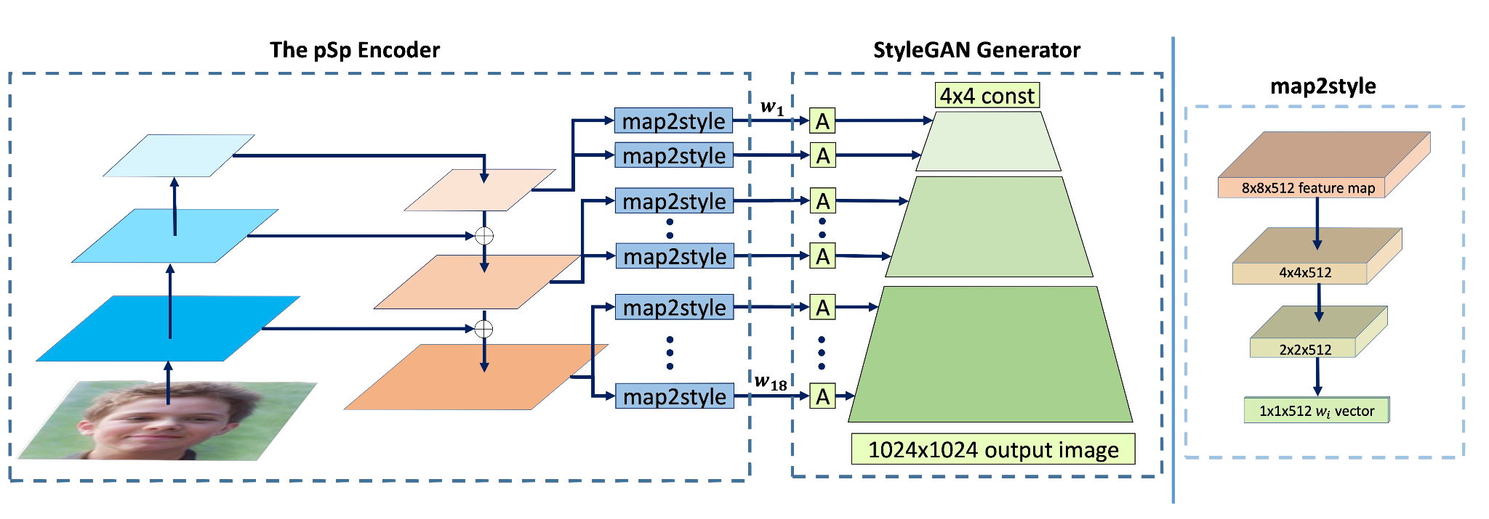
Architecture
StyleGAN encoder for image-to-image translation
Notes:
Here is a slide, where you can see described above framework in a schematic representation. Map2style are simple intermediate networks that extract styles from the feature maps of the encoder.

Slide 7



GAN Inversion
We use pSp to find the latent code of real images in the latent space of a pre-trained StyleGAN generator.
StyleGAN encoder for image-to-image translation

Slide 8
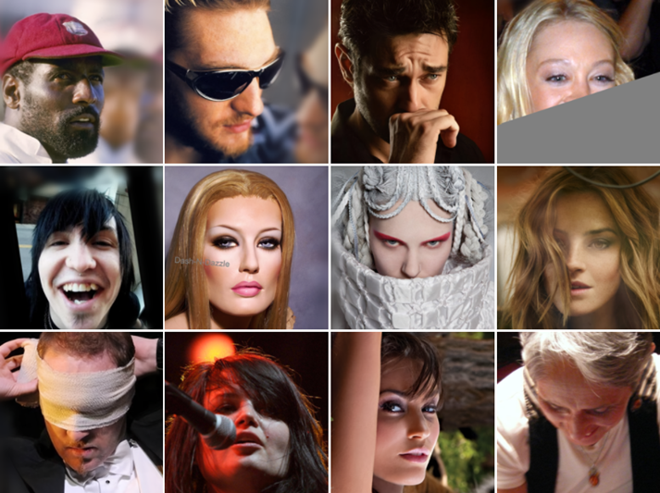
CelebA Dataset
202 599 celebrity images, each with 40 attribute annotations.
The images cover large pose variations and background clutter.
10 177 number of identities
5 landmark locations
Resizing
Rescaling
StyleGAN encoder for image-to-image translation

Slide 9
Results

Slide 10
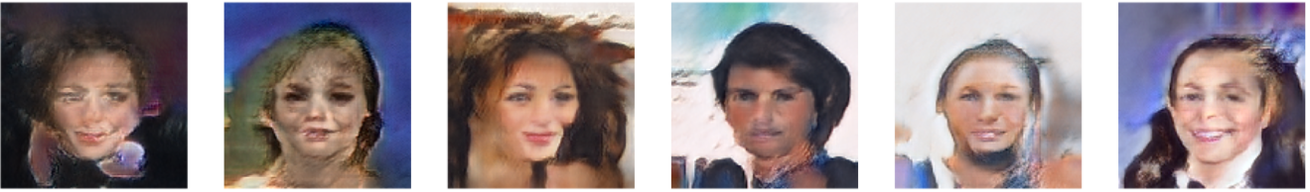
StyleGAN results
Model resolution: 4 x 4
Model resolution: 8 x 8
Model resolution: 16 x 16
Model resolution: 128 x 128
StyleGAN encoder for image-to-image translation

Slide 11
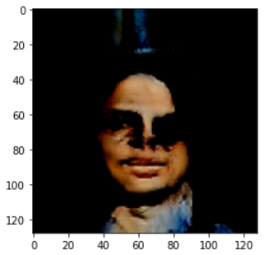
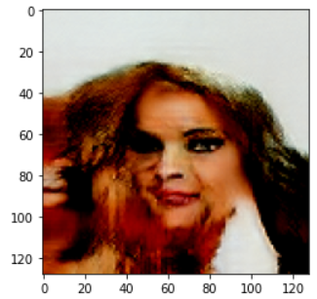
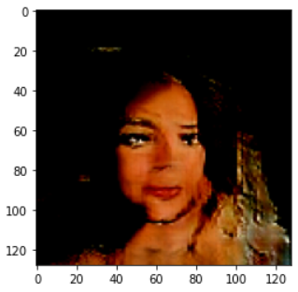
pSp with Encoder
Epochs: 10
Epochs: 20
Epochs: 40
StyleGAN encoder for image-to-image translation

Slide 12
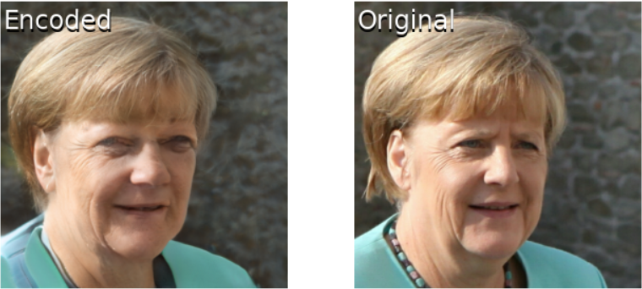
Encoder
StyleGAN encoder for image-to-image translation

Slide 13
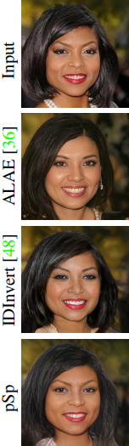
Wrap-Up and Conclusions
APPLICABILITY
PsP can be used to directly encode translation tasks into StyleGAN, thereby supporting input images that do not reside in the StyleGAN domain (out-of-domain support);
Capable of solving a wide variety of image-to-image translation tasks (e.g face frontalization, conditional image synthesis, ect), requiring only minimal changes (training losses and methodology);
Generates the high-quality images;
EXTENSIONS
Going beyond the facial domain;
LIMITATIONS
Method is limited to images that can be generated by StyleGAN;
Globality of approach introduces a challenge in preserving finer details of the input image e.g. earrings, background details);
StyleGAN encoder for image-to-image translation

